Slide 1
RESPONSIVE DESIGN
Chapter 04

Slide 2


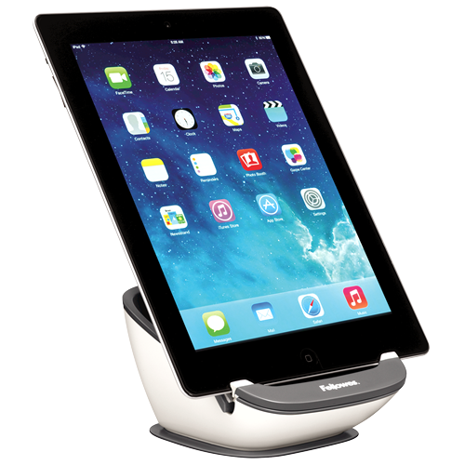
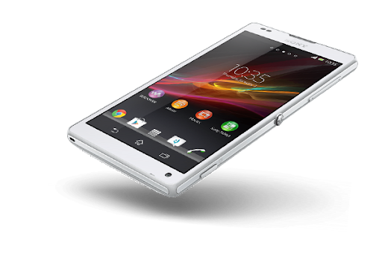
What you will learnt
Understand what is a responsive design
Be able to write CSS breakpoints

Slide 3
EXPLAIN
Responsive web design is a way to design websites that makes web pages display well on any devices and screen sizes.

Slide 4
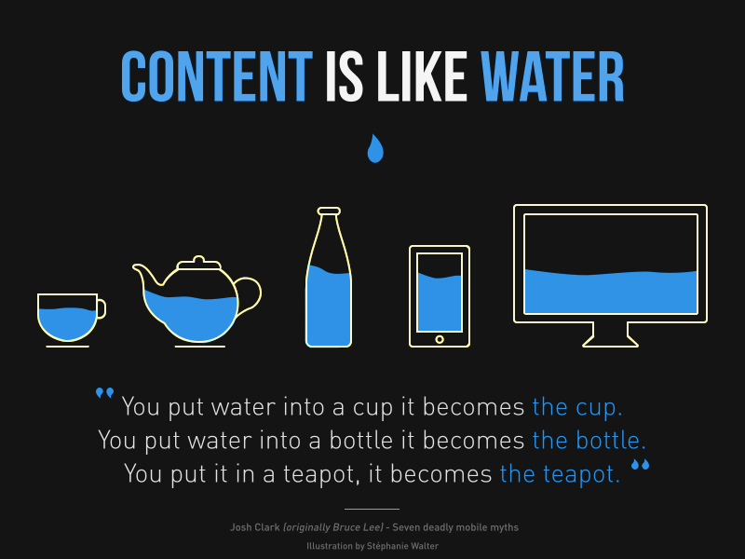
EXPLAIN
Think of the website’s content like water.
we design the website so its content will fit well in all kinds and sizes of containers

Slide 5


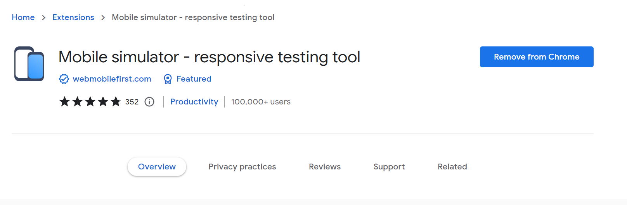
DEMO
How check the website's responsiveness?
05 MIN
CLASS

Slide 6


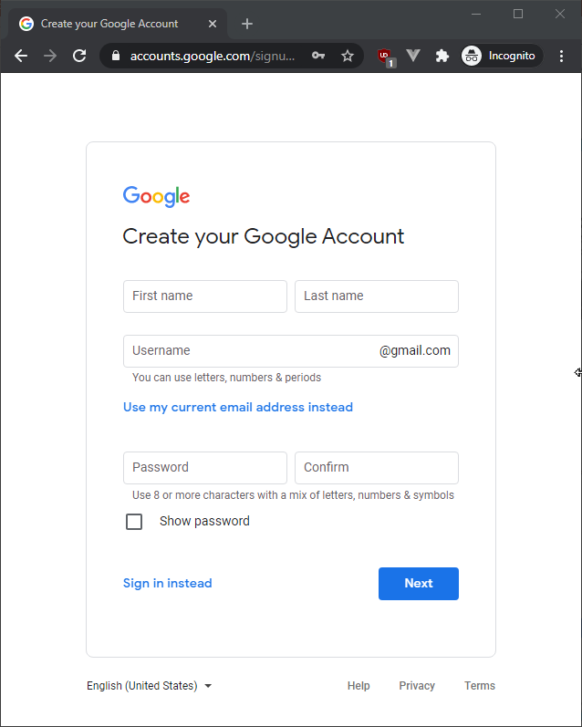
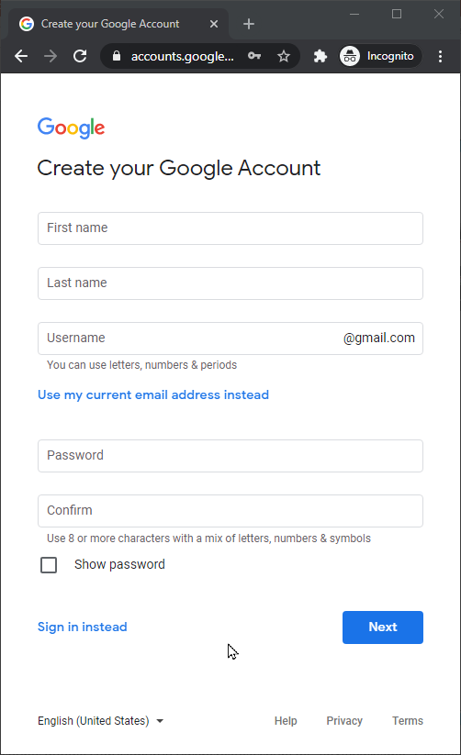


EXPLORE
List down the differences
between the different layouts
05 MIN

Slide 7
EXPLORE
List down the differences
between the different layouts
Image is hidden
First and last name on 1 colum

Slide 8



EXPLORE
List down the differences
between the different layouts

Slide 9

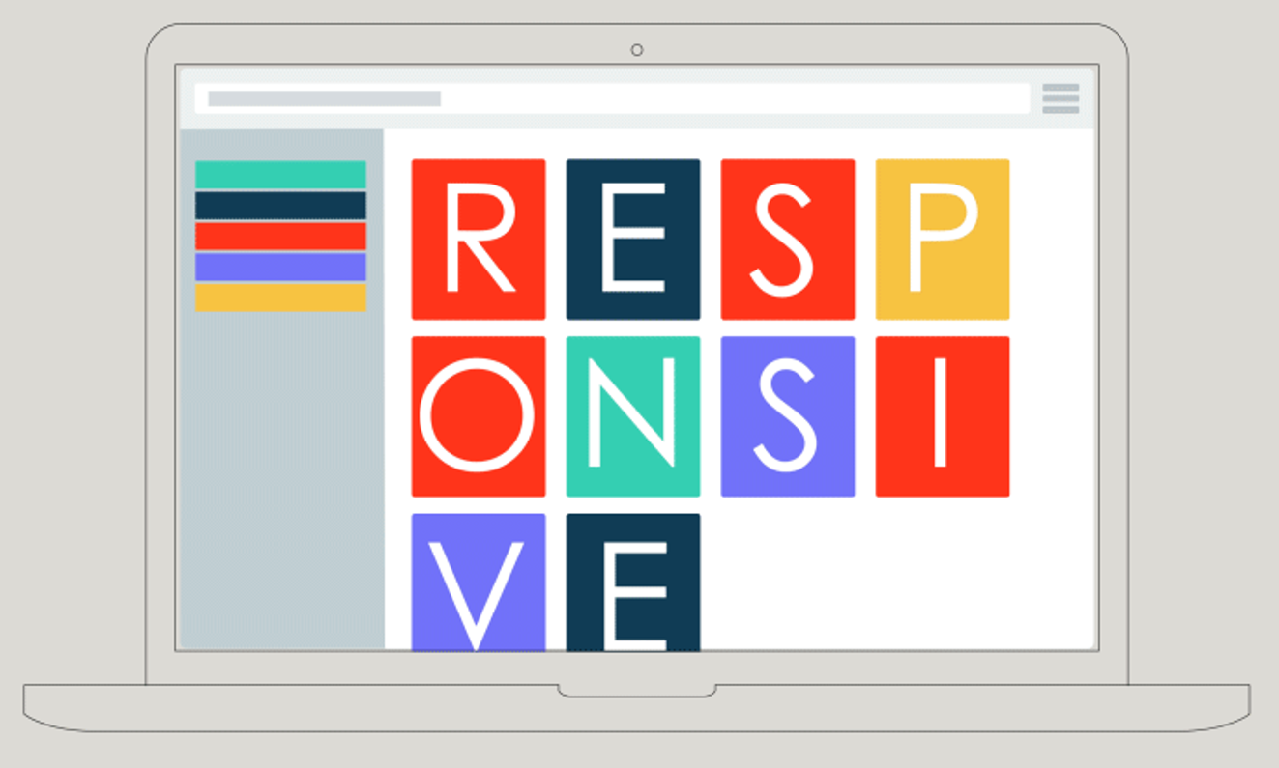
EXPLORE
List down the differences
between the different layouts

Slide 10
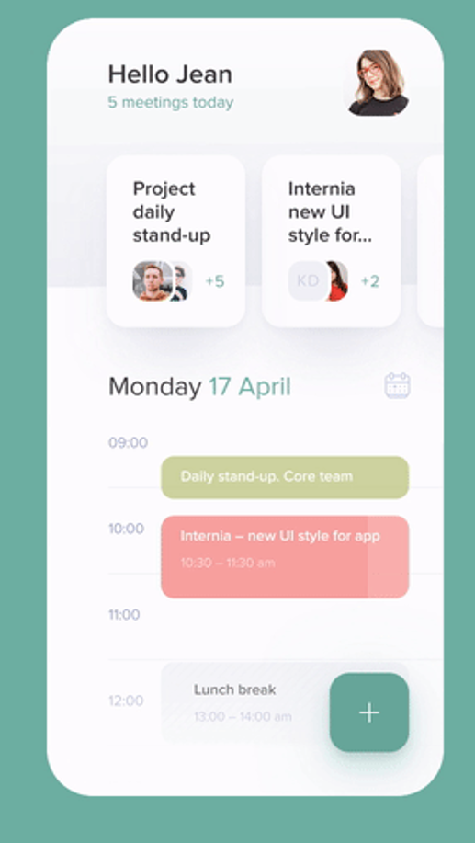
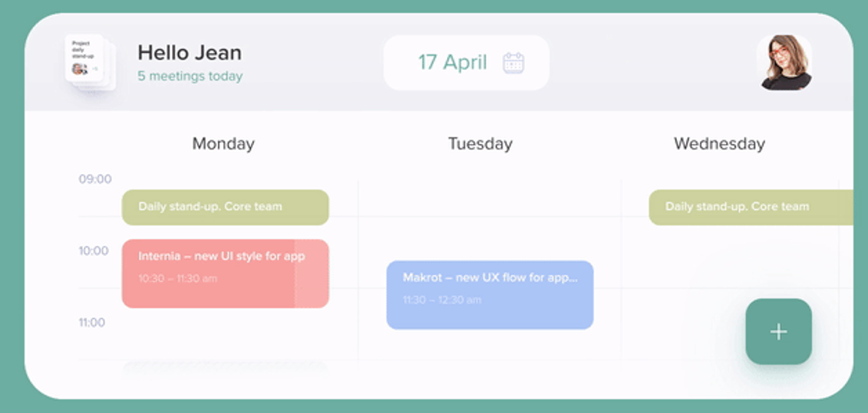
EXPLORE
List down the differences
between the different layouts

Slide 11
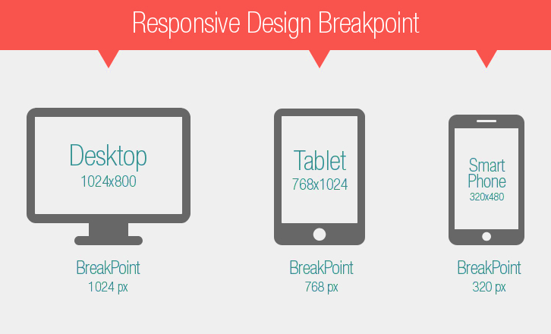
EXPLAIN
Breakpoints
Are points in the CSS that will change how the content is displayed on different screens.
at least 3 breakpoints are needed

Slide 12
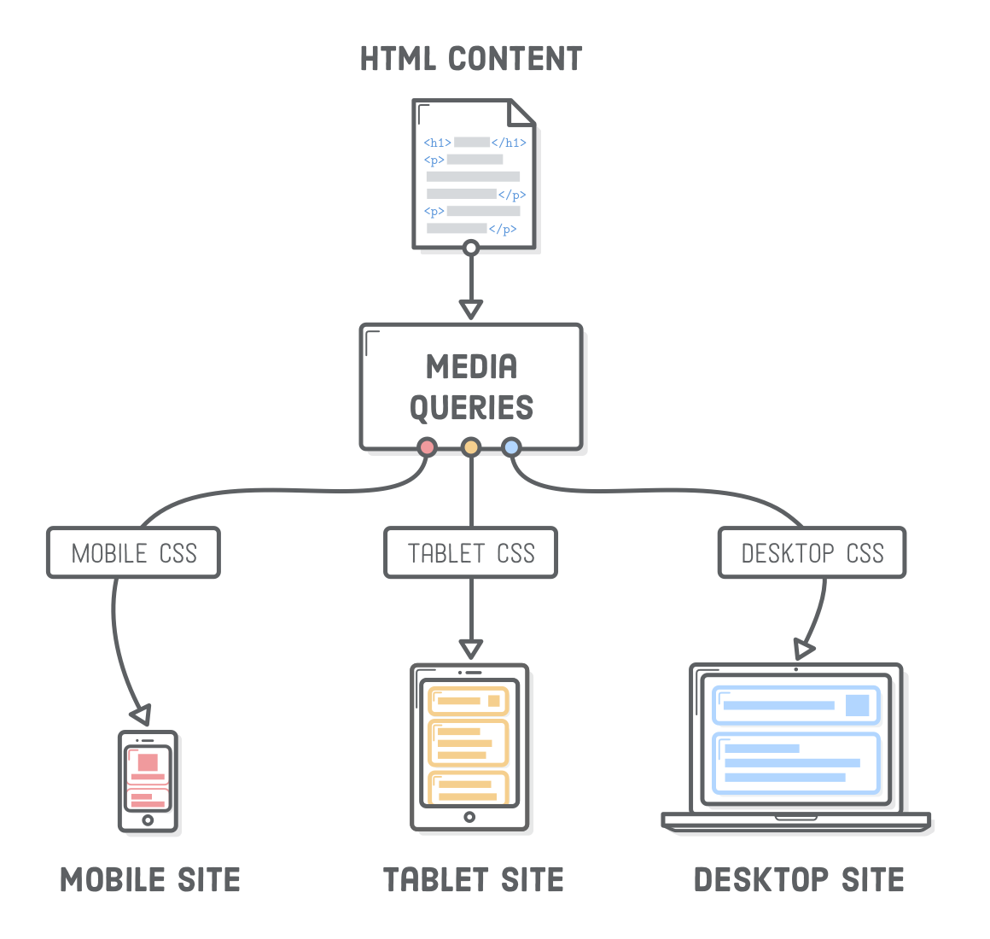
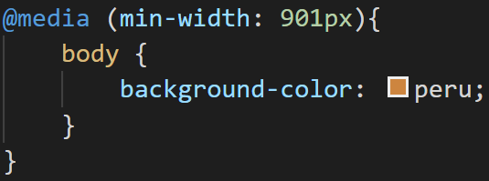
EXPLAIN
Media queries
Is the way to define your breakpoint is your CSS code
Only screen bigger than 901px will have this style

Slide 13
Activity
Activity 1
Code the following design
10 MIN
Individual
By default
Breakpoint 768px
Breakpoint 414 px

Slide 14
Activity
Activity 2
Complete the start code
10 MIN
Individual
A common approach with media queries is to show content as a multicolumn layout for large screens and reduce the number of columns to fit the smaller screens.
Breakpoint 1024px
Breakpoint 768px
Breakpoint 320px

Slide 15

Quiz
10 MIN
Individual
Quiz

Slide 16


#1
What will be the color if the screen width is 200 px ?
<html>
<body>
<h1>Hello PNC !</h1>
<style>
@media (max-width: 300px) {
body {
background-color: blue;
}
}
@media (min-width: 301px) {
body {
background-color: red;
}
}
</style>
</body>
</html>
A
B

Slide 17

#2
What will be the color if the screen width is 100 px ?
<html>
<body>
<h1>Hello PNC !</h1>
<style>
@media (max-width: 300px) and (min-width: 200px) {
body {
background-color: red;
}
}
@media (min-width: 301px) {
body {
background-color: blue;
}
}
</style>
</body>
</html>
A
B
C

Slide 18

#3
What will be the color if the screen width is 210 px ?
<html>
<body>
<h1>Hello PNC !</h1>
<style>
@media (max-width: 200px) {
body {
background-color: red;
}
}
@media (max-width: 300px) and (min-width: 201px) {
body {
background-color: blue;
}
}
@media (min-width: 301px) {
body {
background-color: green;
}
</style>
</body>
</html>
A
B
C
D

Slide 19

#4
What will be the color if the screen is 210 px width and 310 px height ?
<html>
<body>
<h1>Hello PNC !</h1>
<style>
@media (max-width: 200px) and (min-height: 300px) {
body {
background-color: red;
}
}
@media (min-width: 201px) and (max-height: 301px){
body {
background-color: blue;
}
}
@media (max-width: 200px) and (max-height: 300px) {
body {
background-color: green;
}
}
@media (min-width: 201px) and (min-height: 301px){
body {
background-color: yellow;
}
}
</style>
</body>
</html>
A
B
C
D

Slide 20

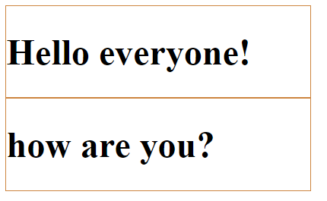
#5
How the div will be dislplay if the screen width is 400 px ?
<html>
<body>
<div>
<h1>Hello everyone!</h1>
</div>
<div>
<h1>how are you?</h1>
</div>
<style>
div {
display: inline-block;
border: 1px solid peru;
}
@media (max-width: 400px) {
div {
width: 95%;
}
}
@media (min-width: 401px) {
div {
width: 45%;
}
}
</style>
</body>
</html>
A
B

Slide 21

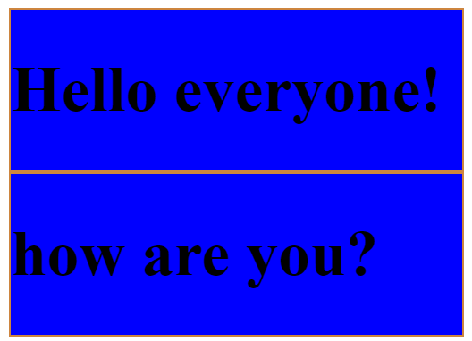
#6
How the div will be displays if the screen is 500 px width and 300px height?
<html>
<body>
<div>
<h1>Hello everyone!</h1>
</div>
<div>
<h1>how are you?</h1>
</div>
<style>
div {
display: inline-block;
border: 1px solid peru;
}
@media (max-width: 400px) and (max-height: 300px) {
div {
width: 95%;
background-color: blue;
}
}
@media (min-width: 401px) and (min-height: 301px) {
div {
width: 45%;
background-color: red;
}
}
</style>
</body>
</html>
A
B
C
D

